Slide 1
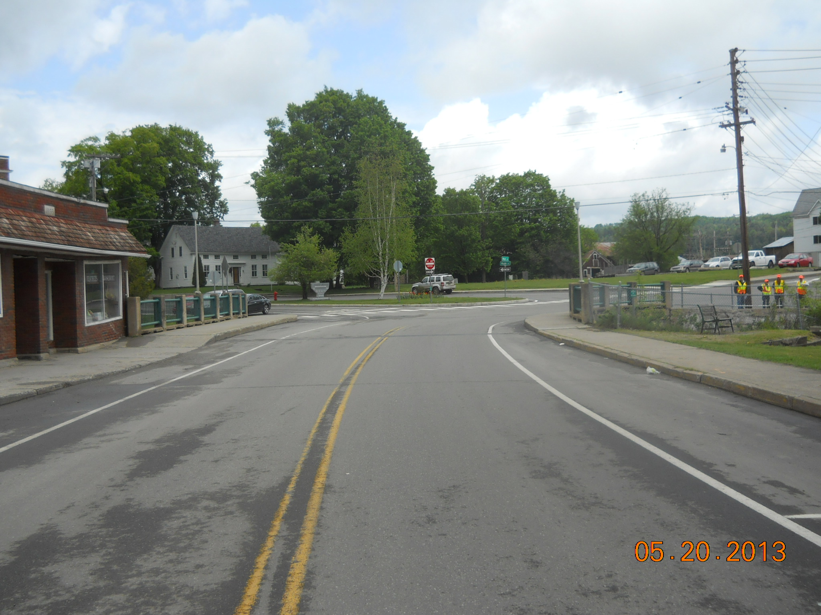
Orleans Village BF 0310(7) Project Update Presentation VT Route 58 (Main Street/TH 1) – Bridge #10 over Barton River
June 26, 2017

Slide 2
Introductions
Doug Bonneau, P.E.
VTrans Project Manager
David Peterson, P.E.
VTrans Project Engineer
Chris Mooney
VTrans Design Engineer
Geoff Dargan
VTrans Design Engineer

Slide 3
Purpose of Meeting
Provide an understanding of our approach to the project
Provide an overview of project constraints
Discuss where we are at in the design process
Provide an opportunity to ask questions and voice concerns

Slide 4
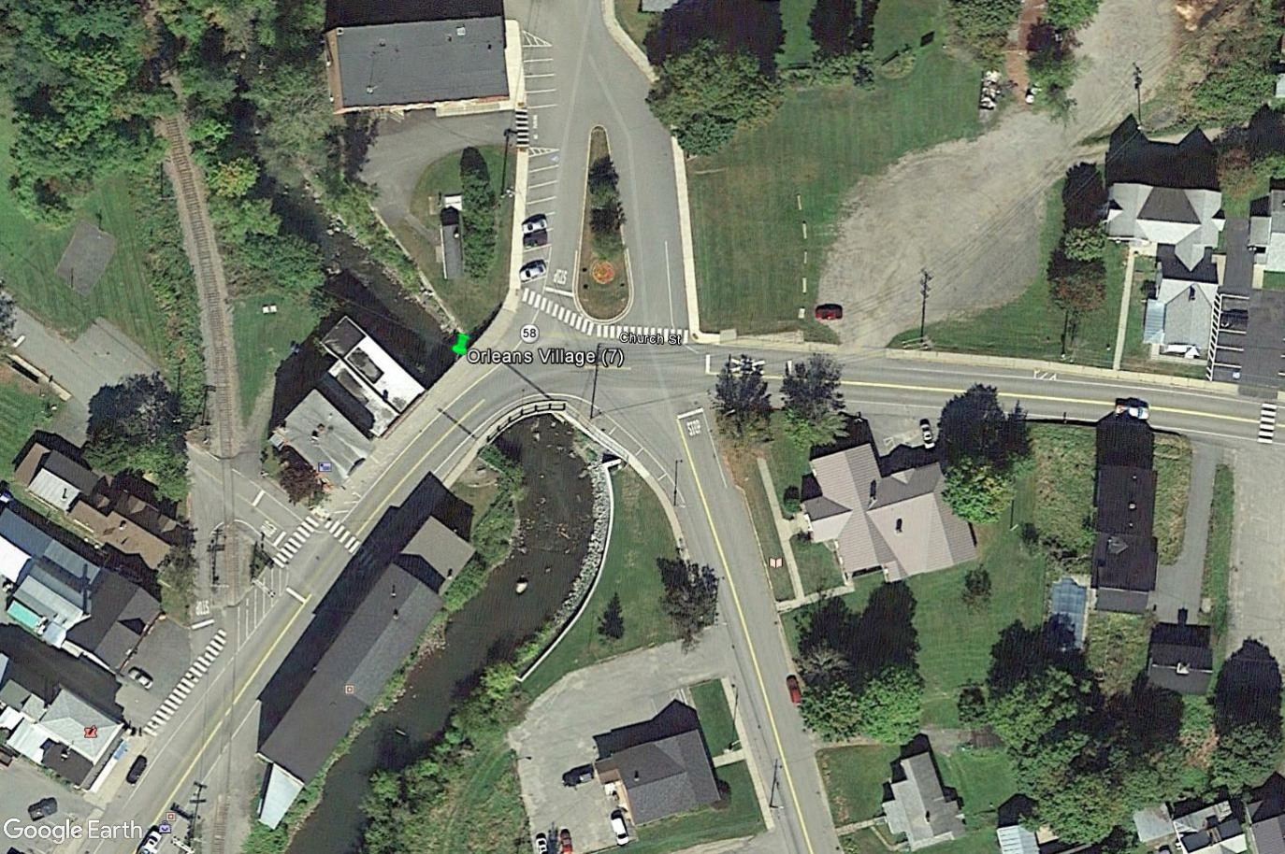
Project Location

Slide 5
Meeting Overview
VTrans Project Development Process
Project Overview
Existing Conditions
Proposed Bridge
New Layout of Intersection with parking and monument relocation
Maintenance of Traffic
Project Cost
Next Steps
Questions

Slide 6
VTrans Project Development Process
Project
Funded
Project
Defined
Contract
Award
Project Definition
Project Design
Construction
Identify resources & constraints
Evaluate alternatives
Public participation
Build Consensus
Environmental permits
Develop plans, estimate and specifications
ROW process

Slide 7
Project Overview
Existing Conditions
Proposed Bridge
Proposed Intersection Layout

Slide 8
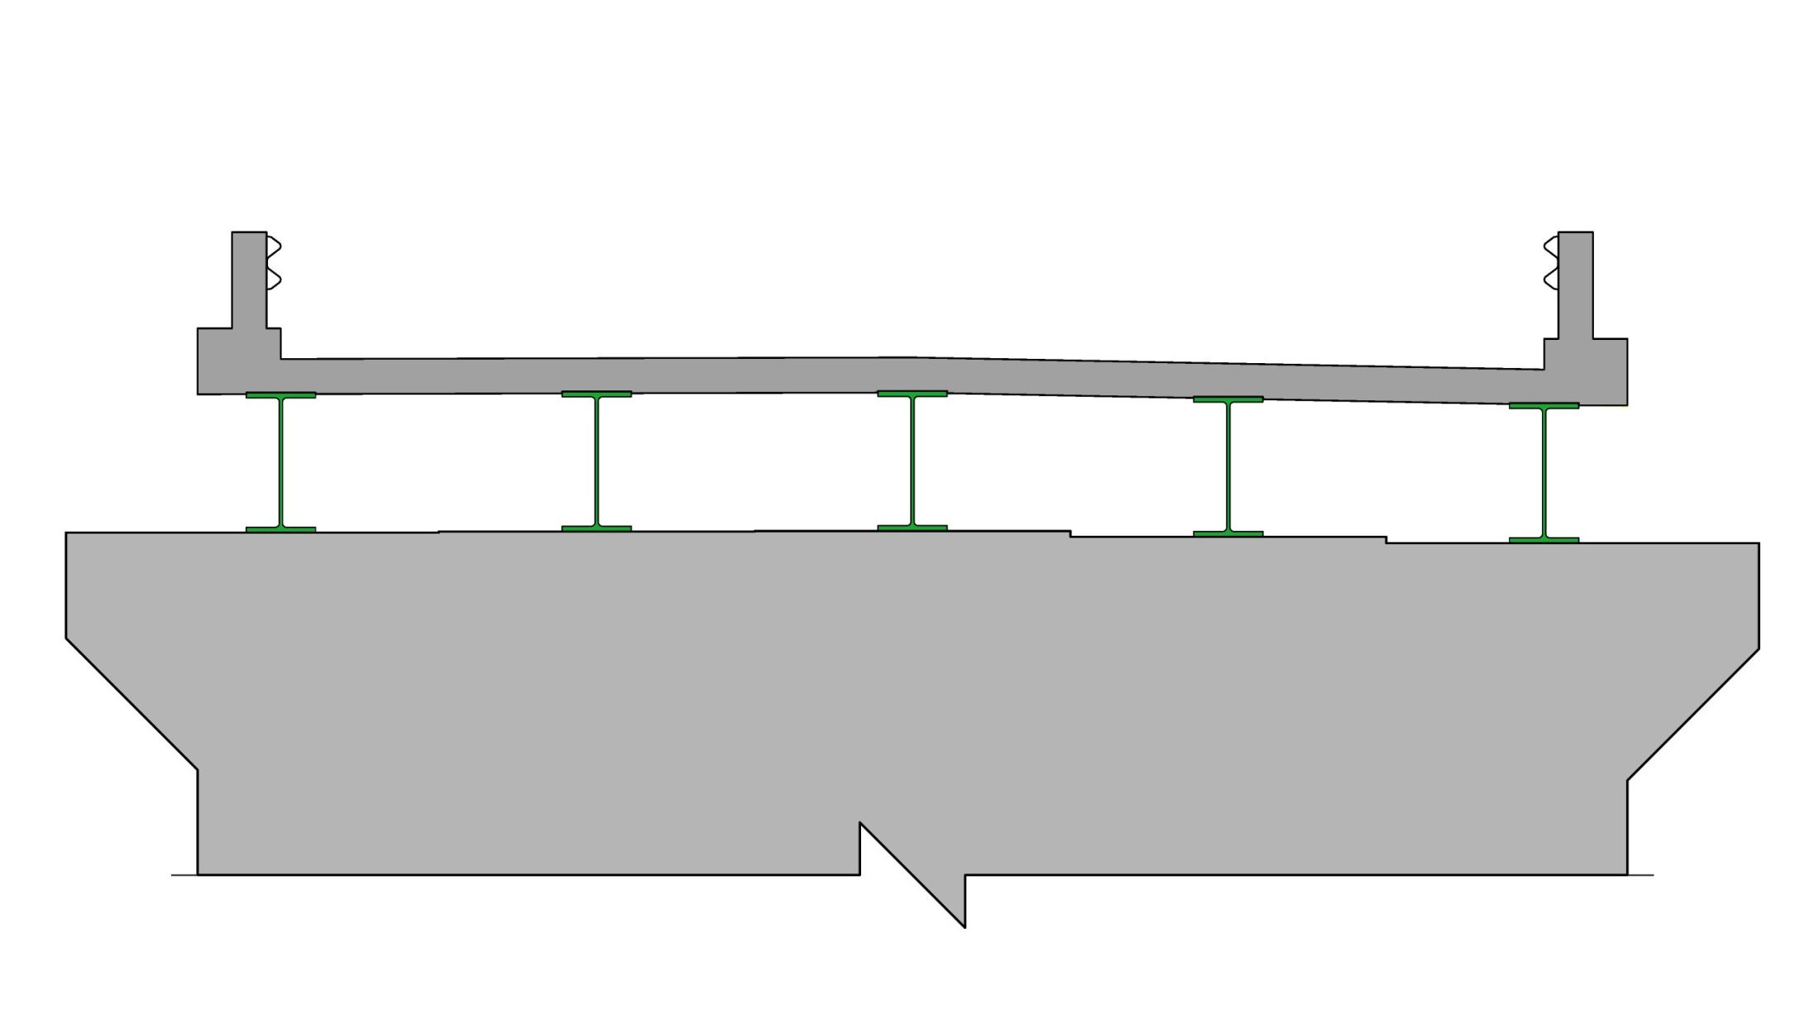
Description of Terms Used
Bridge Rail
Deck
Beams
(Superstructure)
Abutment
(Substructure)
Cross Section of Bridge

Slide 9
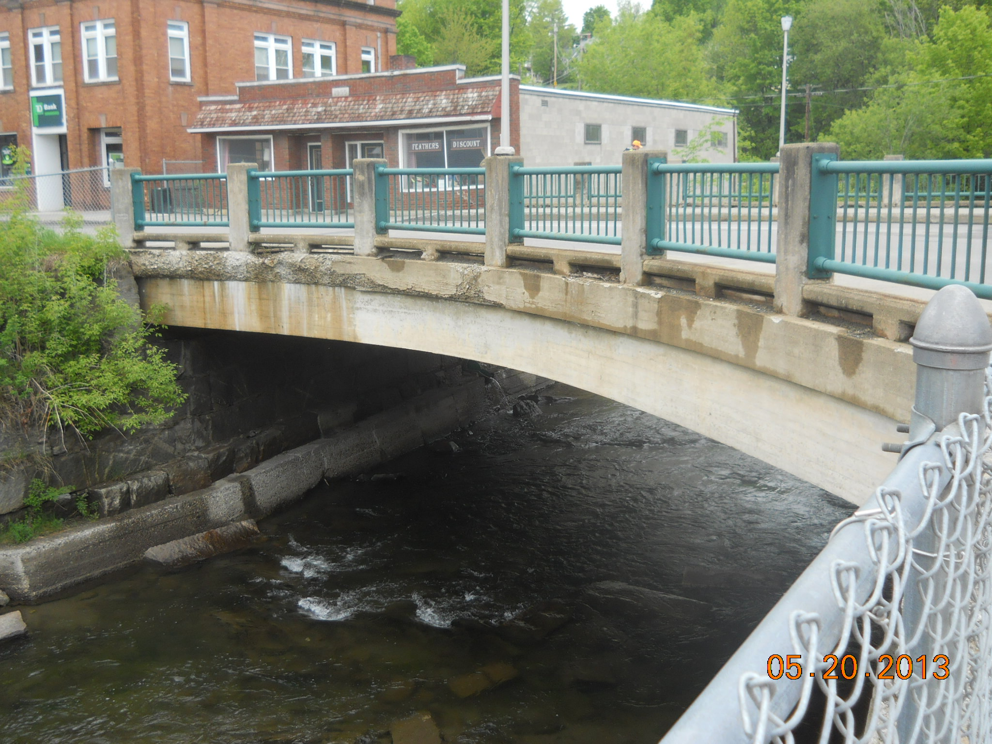
Existing Conditions – Bridge #10
Roadway Classification – Rural Major Collector (Class 1 TH)
Bridge Type – 46’ Long Concrete T-Beam Bridge
Constructed in 1933
Ownership – Village of Orleans

Slide 10
Existing Conditions – Bridge #10
The deck is in poor condition. There are areas of localized deterioration in the Concrete T-Beams
The horizontal curve is substandard
The existing vertical alignment through the project location does not meet the current standard
The bridge and approach railings do not meet current standard

Slide 11
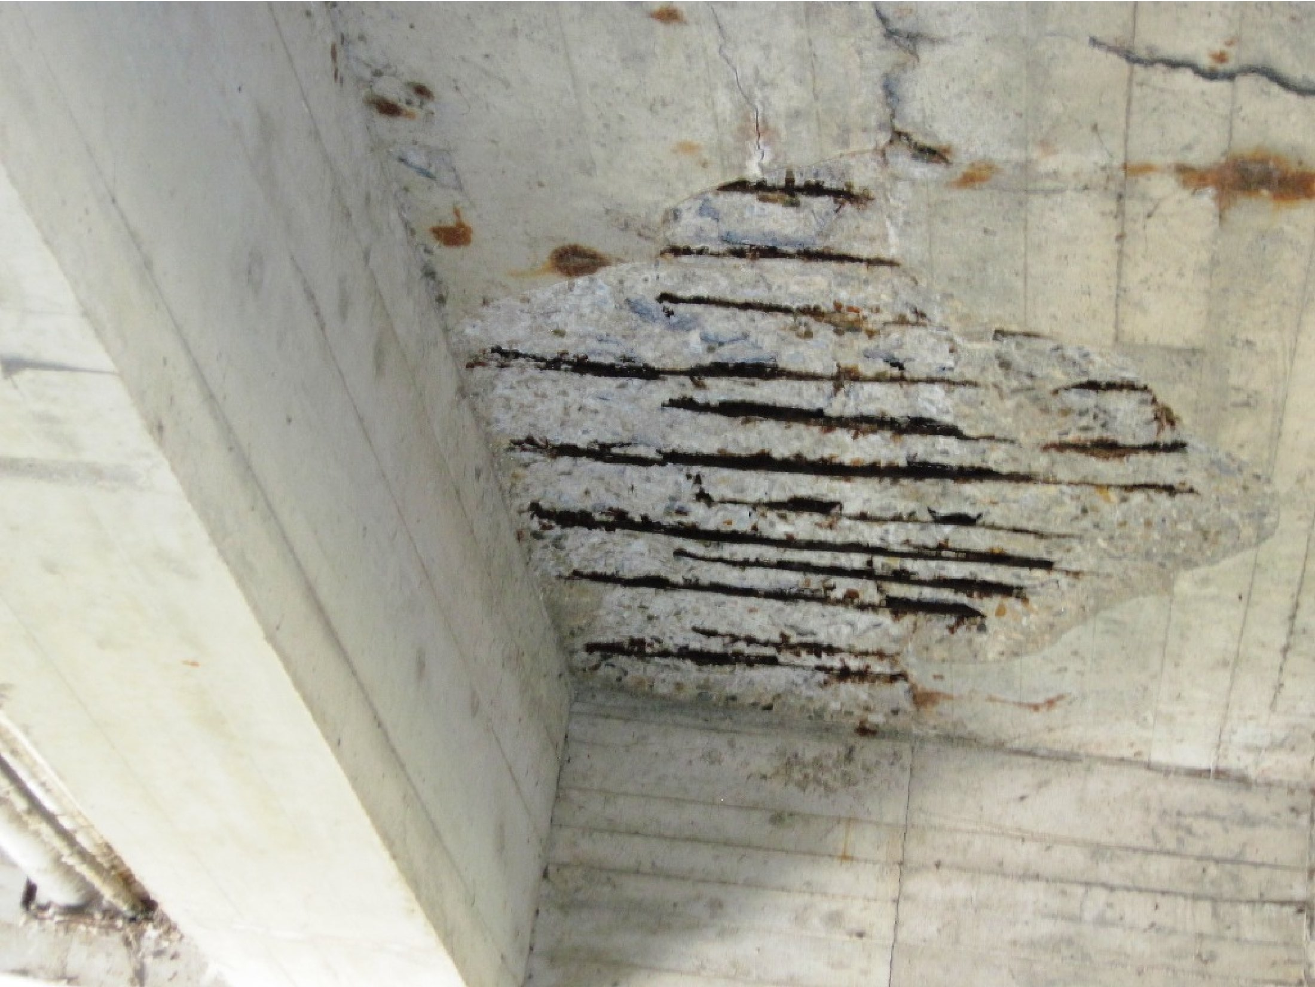
Bridge Deck
Existing Conditions - Bridge #10
Exposed reinforcing steel
At risk for full depth pop-outs

Slide 12
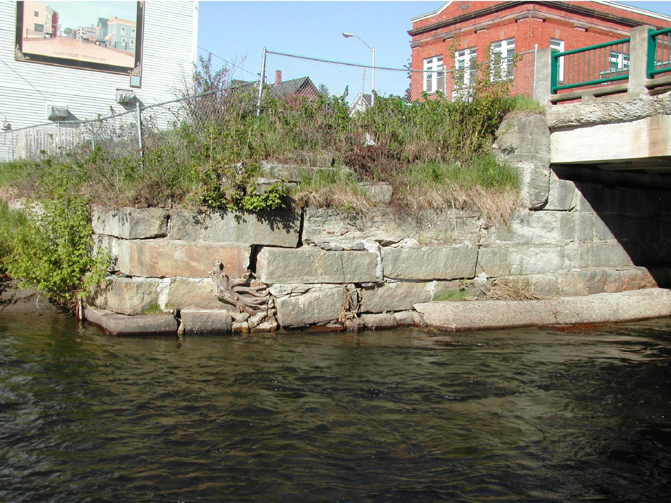
Retaining Wall Issues
Existing Conditions - Bridge #10
Settlement and stability issues
Leaching of fines

Slide 13
Design Criteria and Considerations
ADT of 4,900
DHV of 550
% Trucks: 3.0
Design Speed of 30 mph
Substandard Horizontal Alignment
Historic Bridge located in Orleans Village Historic District
Surrounding Section 4(f) resources

Slide 14
Proposed Bridge #10
Full Replacement Off Alignment
Replace the existing T-Beams with a new superstructure on a completely new substructure
Construction will be phased – Maintain one lane traffic on half the existing bridge. Signalized for traffic in both directions
Maintain existing width
New bridge railing that compliments the Orleans Village Historic District
Horizontal curve will be improved to meet standards and improve sight distance
Utility relocation needed – Most of this work has already been completed
ROW needed
Construction will last for a full season (April – November)

Slide 15
Proposed Typical Section
Proposed curb to curb = 32’

Slide 16
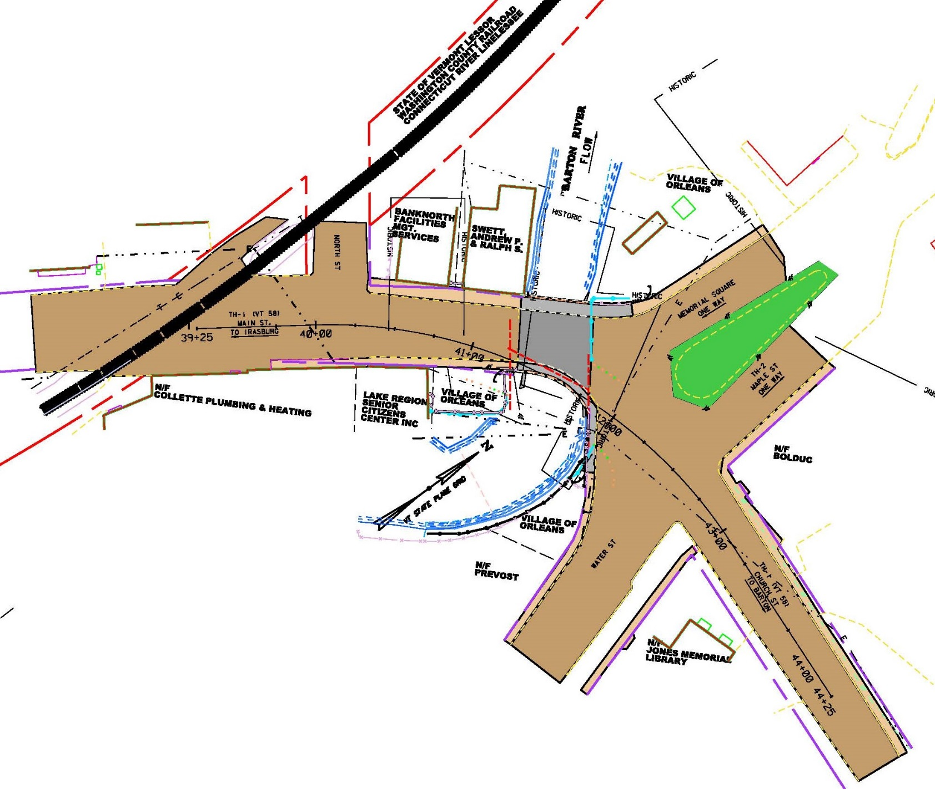
Existing Memorial Park

Slide 17
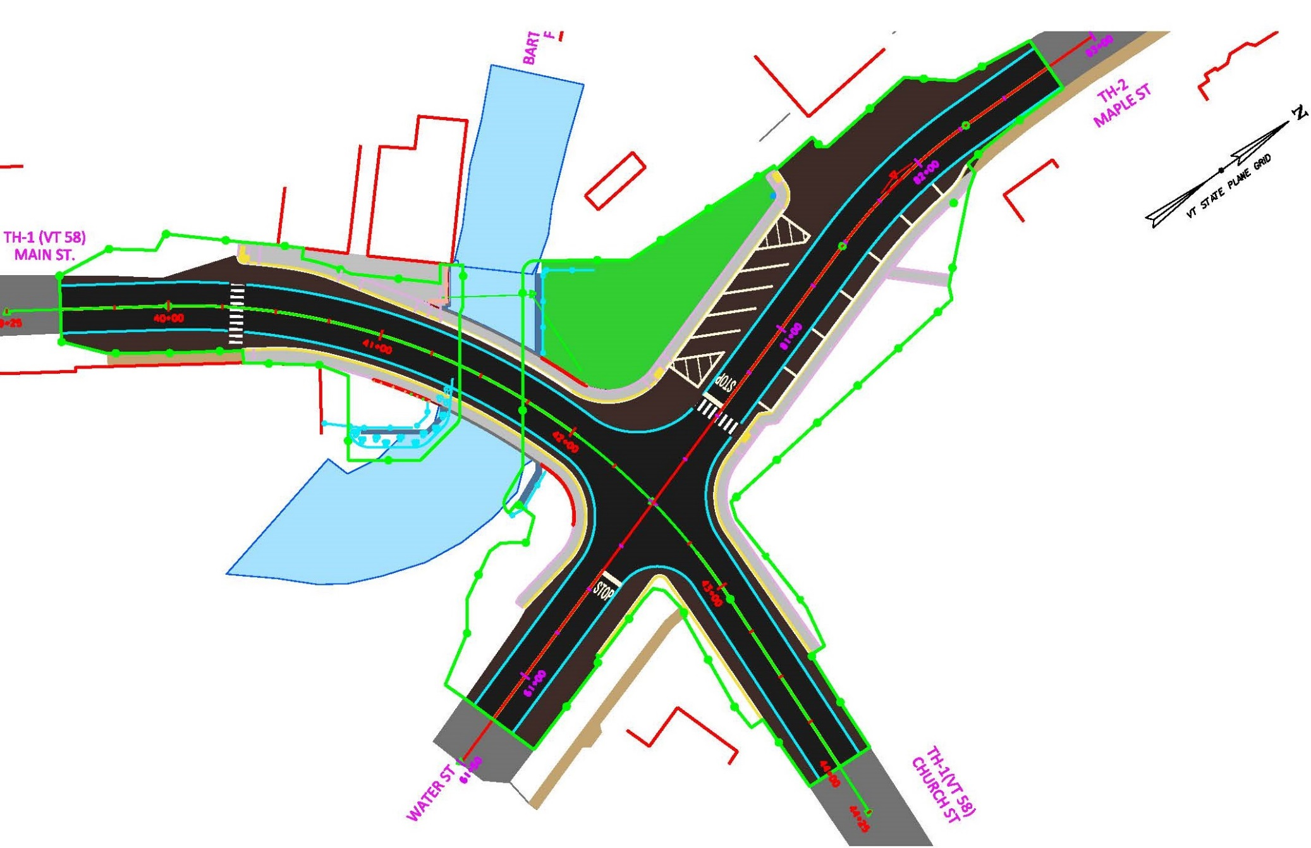
Proposed Memorial Park Layout

Slide 18
Intersection Layout
Parking
Currently 15 marked parking spaces on Water and Maple Street
New parking layout will include 15 legally marked spaces.
Memorial
The existing memorial and park bench will be relocated to a new grassed area west of its current location
Creates a small park area where pedestrians will not need to cross the road to view the memorial

Slide 19
Maintenance of Traffic Options
Phased Construction
Allows bridge to stay open during most of construction
Longer construction duration
Altered safety concerns
Will require short closures of 2-3 weeks
Water Street to be closed to thru traffic at the intersection with VT 58 for duration of Phased Construction.
Would require a fourth signal – increased cost and wait times at light.
Provides space for contractor staging.

Slide 20
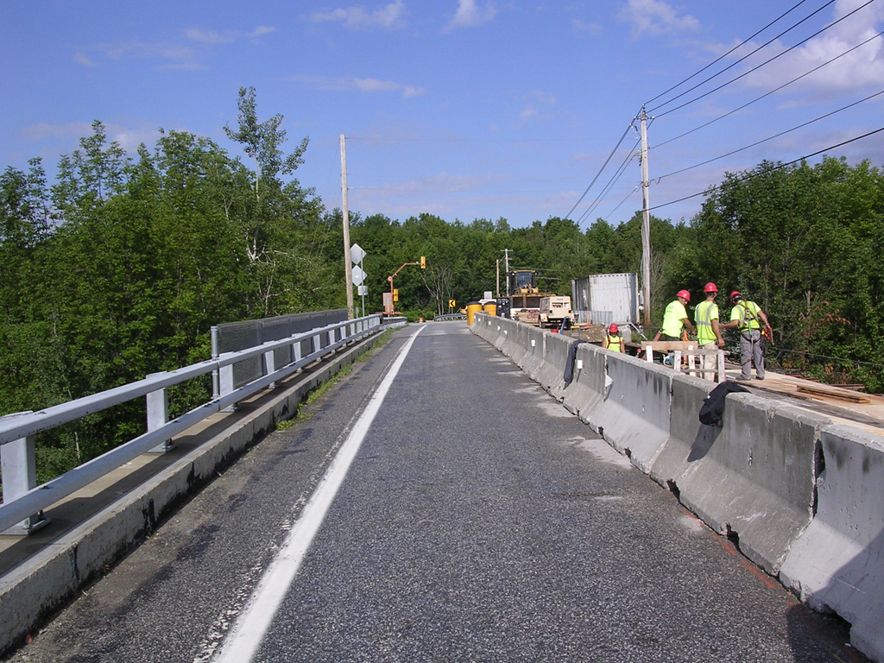
Phased Construction
One lane, alternating, with a traffic signal
Existing is wide enough to complete deck replacement with 2 phases

Slide 21
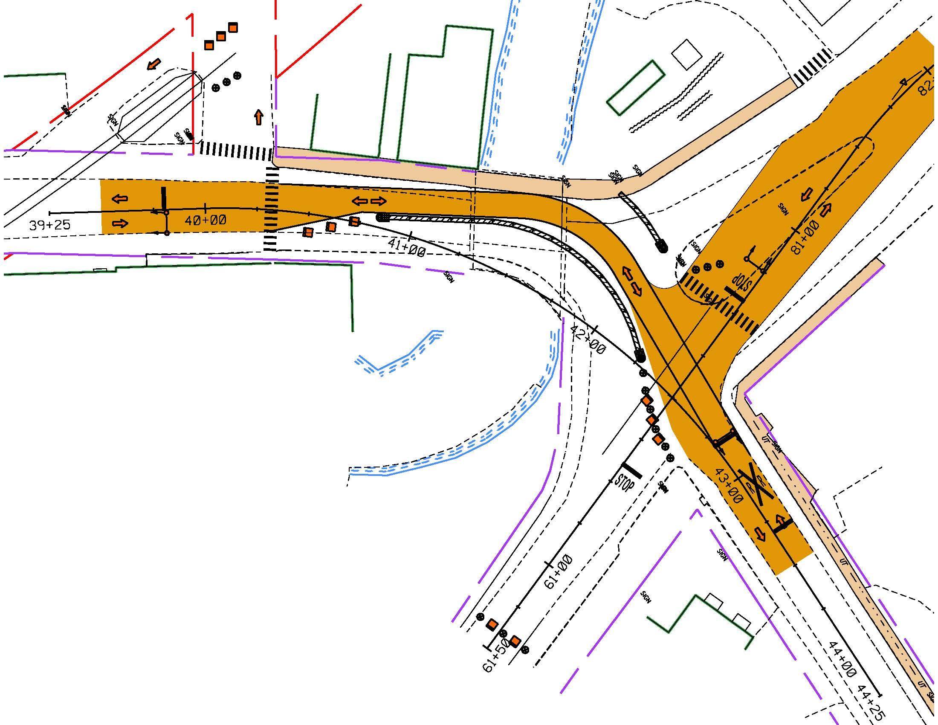
Phased Construction - Phase 1

Slide 22
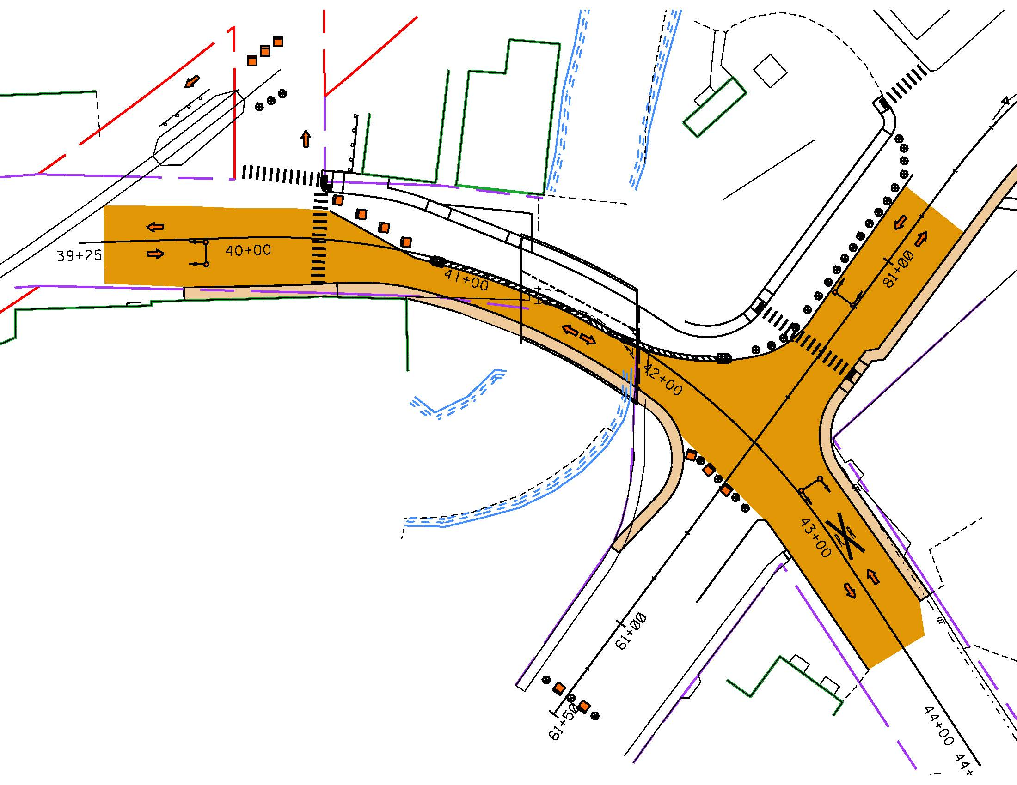
Phased Construction - Phase 2

Slide 23
Project Cost
Preliminary Engineering | $385,000
ROW | $7,500
Construction w/ E & C | $2,900,000
Total | $3,292,500
Town Share is 5% will be approximately $164,625

Slide 24
Next Steps – Bridge #10
This is a list of a few important activities expected in the near future and is not a complete list of activities.
Develop Final Plans
Additional Subsurface Investigation (Borings)
Finalize Environmental Permits
Right-of-Way process

Slide 25
Orleans Village BF 0310(7) Questions & Comments VT Route 58 (Main Street/TH 1) – Bridge #10 over Barton River
For more information:
https://outside.vermont.gov/agency/vtrans/external/Projects/Structures/13J084
June 26, 2017

